Slide 1
Optical access enabling buildings to communicate and sense simultaneously
John Cosmas and Adam Kapovits (kapovits@eurescom.eu)

Slide 2
Why Do Buildings Need New Network Infrastructure?
Emerging 6G Applications have demanding new requirements
  Extended Reality (XR) – increased indoor traffic and high accuracy localisation
  Digital Twins
  Autonomous Robots - Real-time sensing and control and high accuracy localisation
  Smart Manufacturing - Massive indoor traffic and Ultra-low latency requirements
  Intelligent Healthcare - Dense wireless deployments and ultra secure communications
  Human-AI Collaboration - increased indoor traffic and high Energy efficiency
  Wireless (radio) alone cannot meet future indoor communication and intelligence requirements

Slide 3
Vision of the 6G Intelligent Building - From Connected Buildings to Cognitive Buildings
Future Building Characteristics
  Connectivity everywhere
  Continuous sensing
  Intelligent decision-making
  Autonomous operation
  Human-centric services
OPTI-6G Optical access system forms the nervous system of the smart building.
6G Wireless Services
Edge AI and Digital Twin
OPTI-6G Optical Access Network
Sensors and Actuators
Physical Space

Slide 4
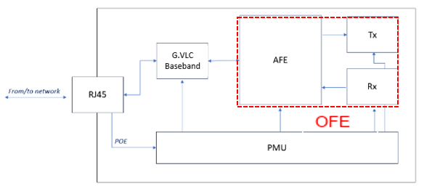
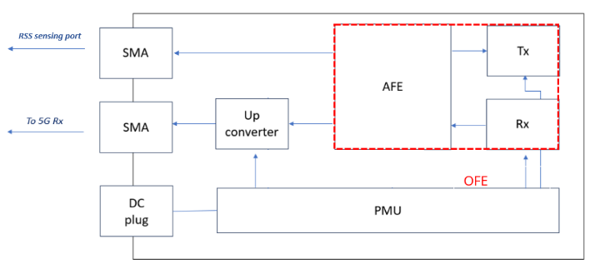
Adaptation of LiFi OWC Antenna to 5G OWC Antenna
The OWC system 5G building blocks have been adapted from baseband part of an existing G.vlc LiFi system.
The G.vlc baseband and the PHY Ethernet has been replaced by an up/down converter (using an RF mixer) to allow using OWC to interface with the 5G network.
ADAPTATION

Slide 5
Integration of 5G OWC Antenna for OPTI-6G Cellfree Test
NIB
Network in a Box (Core + CU + DU)
and
Localisation Server
RADIO
UNIT
3.5GHz
Commercial UE
3.5GHz
ORAN
Option
7.2
UC
Optical Rx
C
INTERNET
5
DC
Optical Tx
Optical Tx
DC
C
ORAN
Option
7.2
RADIO
UNIT
3.5GHz
Optical Rx
UC
Optical Rx
UC
C
5
DC
Optical Tx
5
Attenuator 5dB
C
Circulator 3.5GHz
DC
Downconverter from 3.5GHz to 50Mhz
UC
Upconverter from 50 MHz to 3.5 GHz

Slide 6
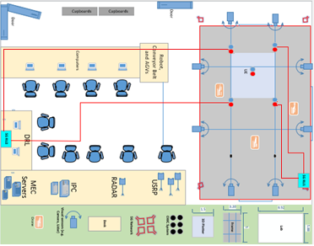
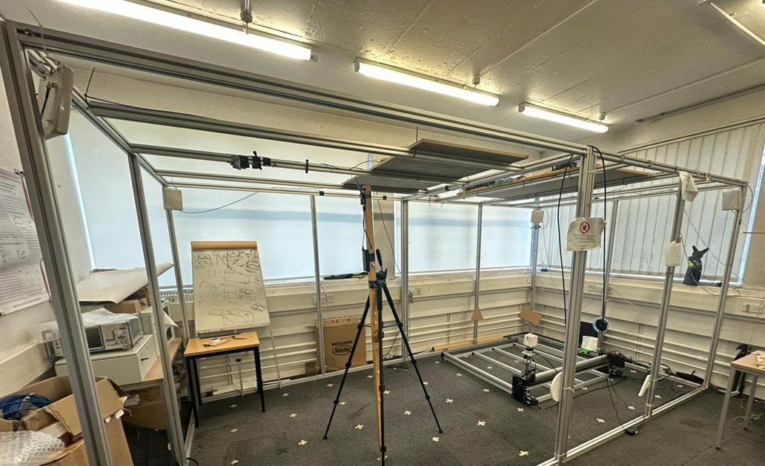


Cellfree Lab Configuration

Slide 7
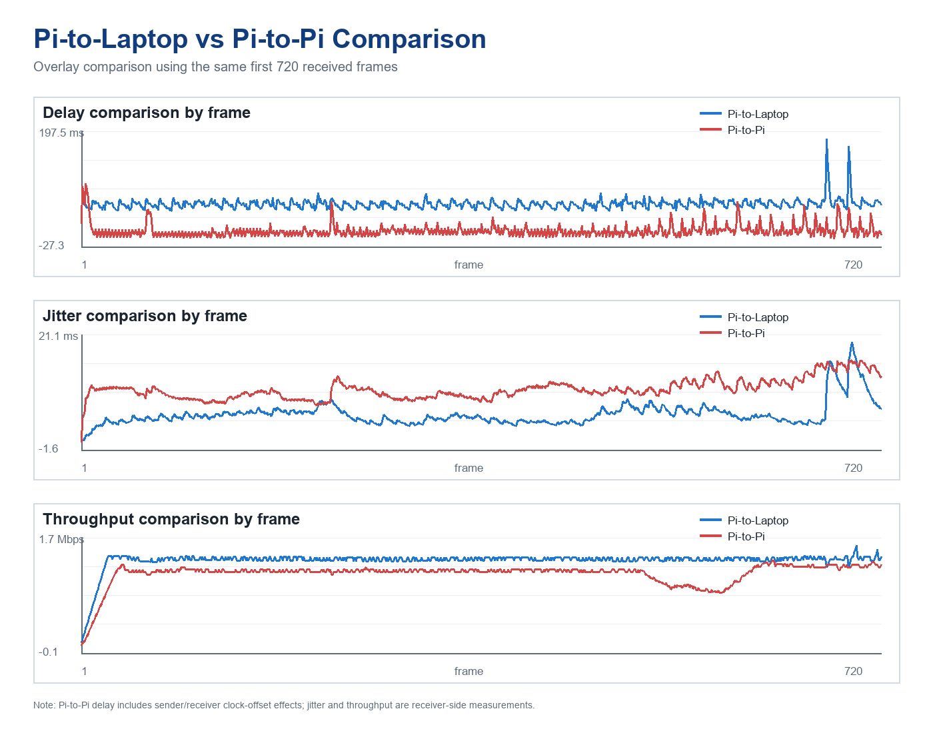
Preliminary Cellfree Streaming Performance Tests
The preliminary experimental setup uses a laptop receiver and a Raspberry Pi camera streamer connected through a private 5G-box setup.
The laptop uses a Telit Remote NDIS6 air interface and has local Telit LAN address 192.168.225.150.
The Raspberry Pi uses a Quectel device on wwan0 and has address 192.168.2.2.
The experiment will be repeated using 5G OWC antenna system
Metric | Pi-to-laptop | Pi-to-Pi, first 720 frames
Frames compared | 720 | 720
Duration | 29.96 s | 23.98 s
Lost frames | 0 | 0
Avg. delay | 55.62 ms | 3.56 ms*
Max delay | 182.04 ms | 95.12 ms
Avg. jitter | 5.42 ms | 10.31 ms
Max jitter | 19.55 ms | 16.06 ms
Avg. throughput | 1.376 Mbps | 1.163 Mbps
Avg. FPS | 24.10 | 29.85

Slide 8
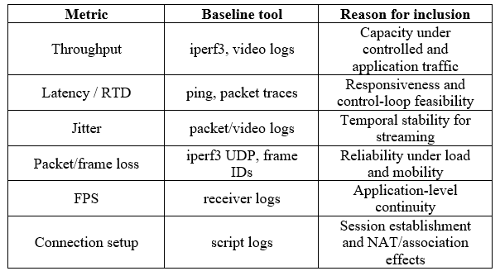
Proposed Common Metrics for Future Sub-6 GHz and Infrared OWC Network Comparison
Proposed metrics for 5G OWC antenna system

Slide 9
Integration of 5G OWC Antennas for OPTI-6G TDoA Localisation Test
C
5
DC
Optical Tx
NIB
Network in a Box (Core + CU + DU)
and
Localisation Server
RADIO
UNIT
3.5GHz
Commercial UE
3.5GHz
ORAN
Option
7.2
UC
Optical Rx
INTERNET
Optical Tx
DC
Optical Rx
C
C
UC
Optical Rx
UC
C
UC
Optical Rx
C
UC
Optical Rx
5
Attenuator 5dB
C
Circulator 3.5GHz
DC
Downconverter from 3.5GHz to 50Mhz
UC
Upconverter from 50 MHz to 3.5 GHz

Slide 10
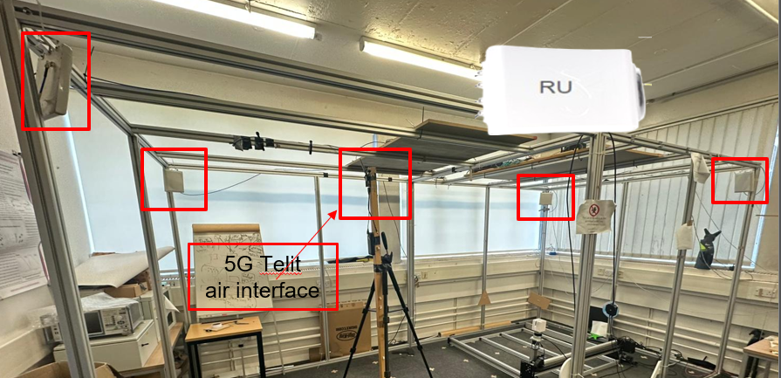
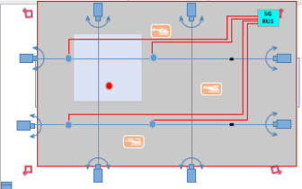
Lab setup for 5G OWC Antennas for OPTI-6G TDoA Localisation Test
Four panel antennas connect to RU
One 5G Telit Air interface for UE

Slide 11
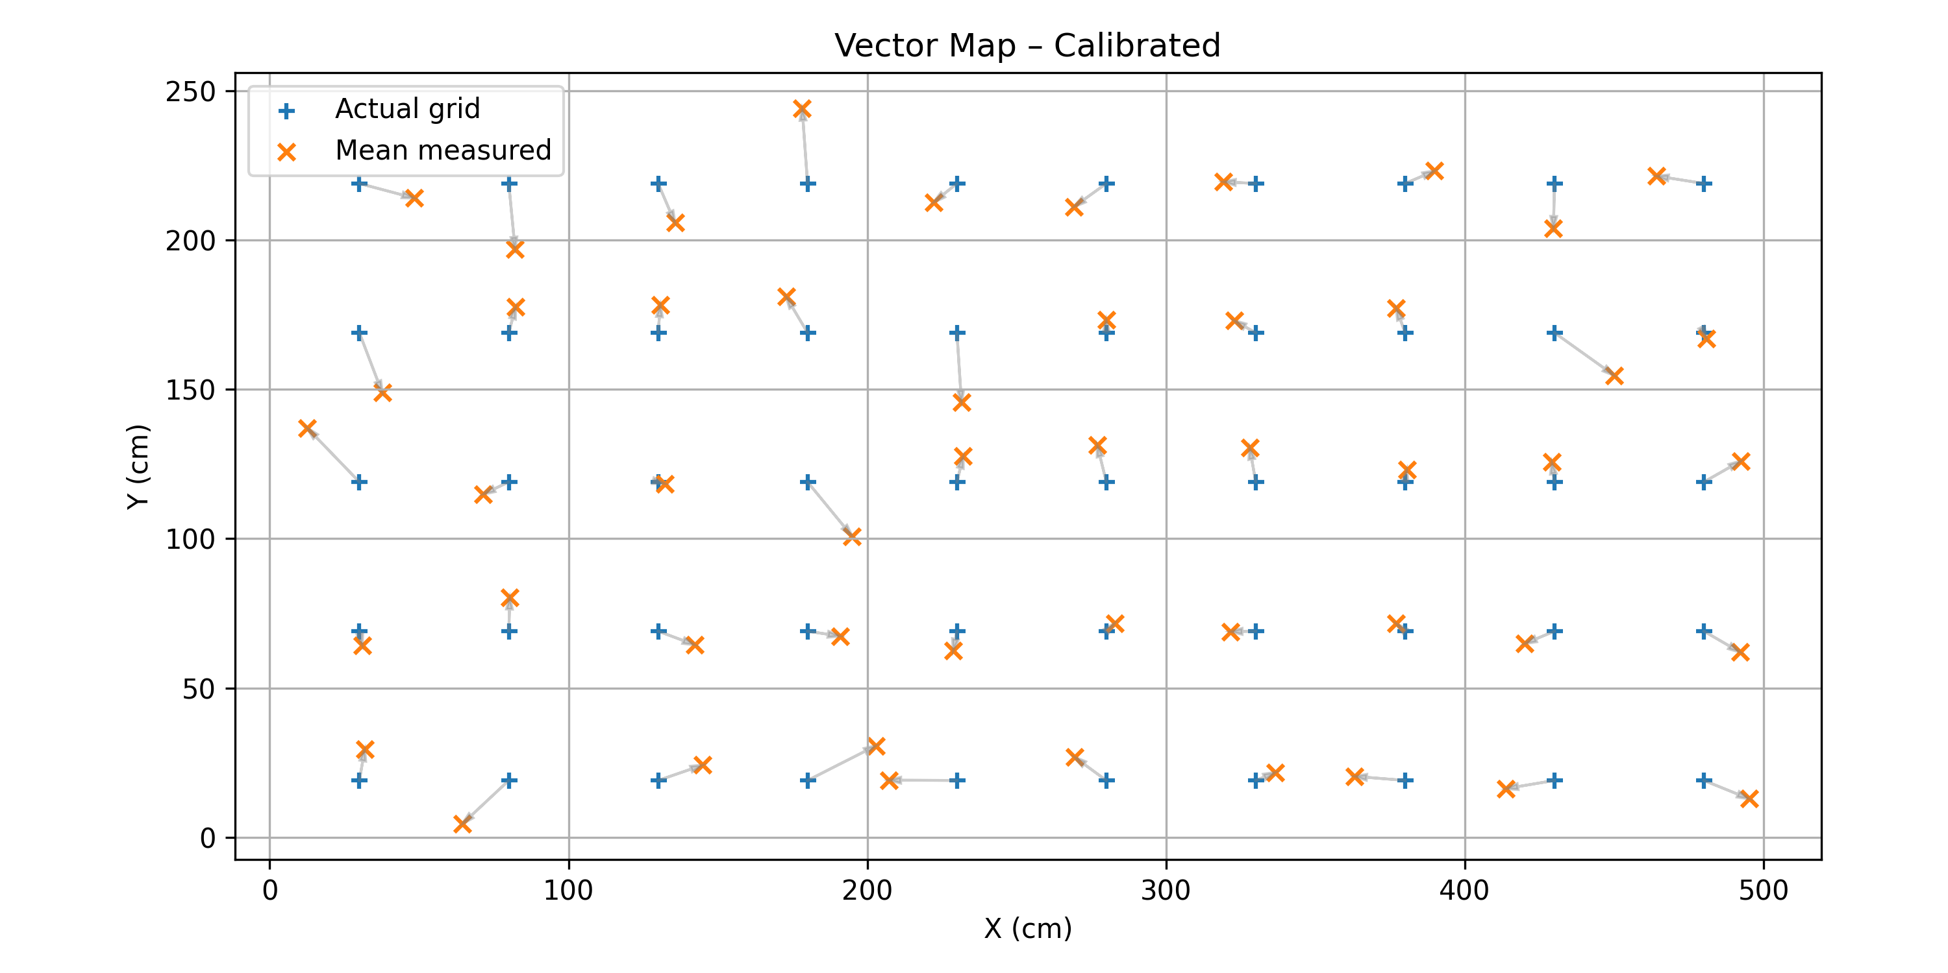
Preliminary Reference Indoor TDoA-Based Localisation Test Results Using Sub-6 GHz
Across the full 50-point grid, the uncalibrated data produced an overall RMSE of 14.7 cm, as computed from the full 2500 sample dataset.
The central region of the grid exhibits the tightest confidence bounds, typically within ±1.2–2.8 cm, reflecting high measurement consistency and favourable geometric conditions.
The experiment will be repeated using 5G OWC antenna system

Slide 12
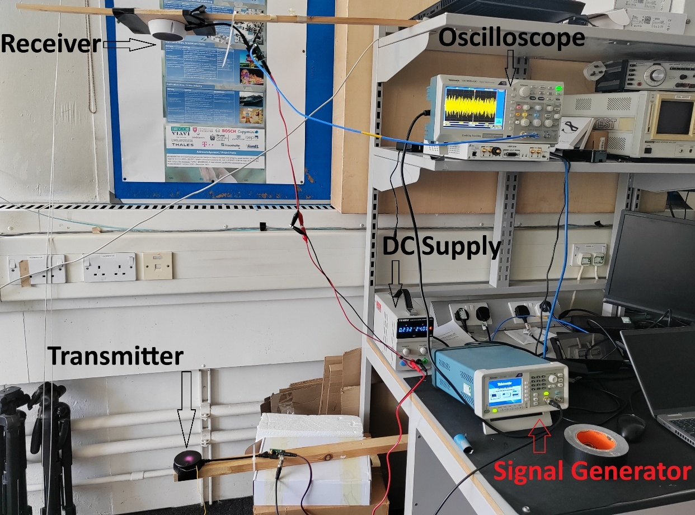
Validate RSS Testbed
Scenario 1: Impact of varying transmit power on the received signal. A 30 MHz sine wave is used as the transmit signal, applied at three different power levels: 20 mVrms, 30 mVrms, and 40 mVrms and the resulting received signal is then studied using the TBS 1052B-EDU digital oscilloscope.
Scenario 2: Impact of varying transmit distance on the received signal. It considers different distances between the TX and RX – D1 = 1.522 m, D2 = 1.284 m, and D3 = 1.090 m – whereas the transmit power of the transmitted 30 MHz sine wave is kept constant (20 mVrms).
Scenario 3: This scenario tests the lab setup in with a processing platform in place of the TBS 1052B-EDU digital oscilloscope to process measurements from multiple optical antennas simultaneously in real time.

Slide 13
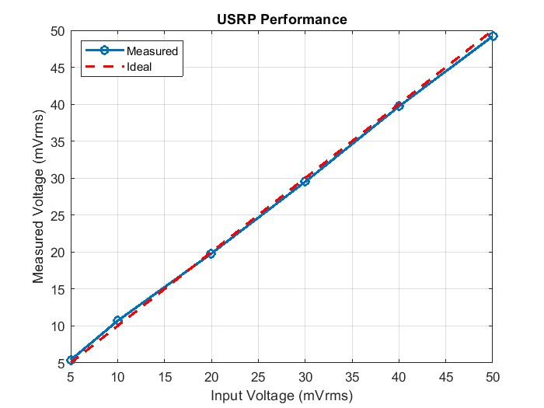
RSS Test Results
Scenario 1: measurements confirm that the optical wireless link provides a nearly linear gain response with modest compression at higher input levels. The effective voltage gain is ~21.3 V/V (≈ 26–28 dB), and the received power levels (5–13 mW into 50 Ω) are consistent with expectations for the tested conditions.
Scenario 2: The results confirm that the RSS is distance-dependent, with higher amplitudes observed at shorter separations. The system demonstrates the expected trend of stronger coupling as TX and RX move closer. However, the deviations from an ideal propagation law suggest that the measurement setup is affected possibly by multipath or near-field effects. The values of G are not constant, which implies that the system does not strictly follow the inverse square law as assumed.
Scenario 3: About the accuracy: The relative error between input and measured RMS is small. For example:
  5 mV → 5.4 mV (+8%)
  10 mV → 10.7 mV (+7%)
  50 mV → 49.2 mV (–1.6%)
Accuracy improves at higher amplitudes because quantization noise and offset errors are less significant compared to signal power.
TX Power | Output RMS Voltage | Voltage Gain | Received Power
20 mVrms | 0.496094 V | 27.89 dB | 0.004922 W 6.92 dBm (50 Ω)
30 mVrms | 0.650815 V | 26.73 dB | 0.008471 W 9.28 dBm (50 Ω)
40 mVrms | 0.806959 V | 26.10 dB | 0.013024 W 11.15 dBm (50 Ω)

Slide 14
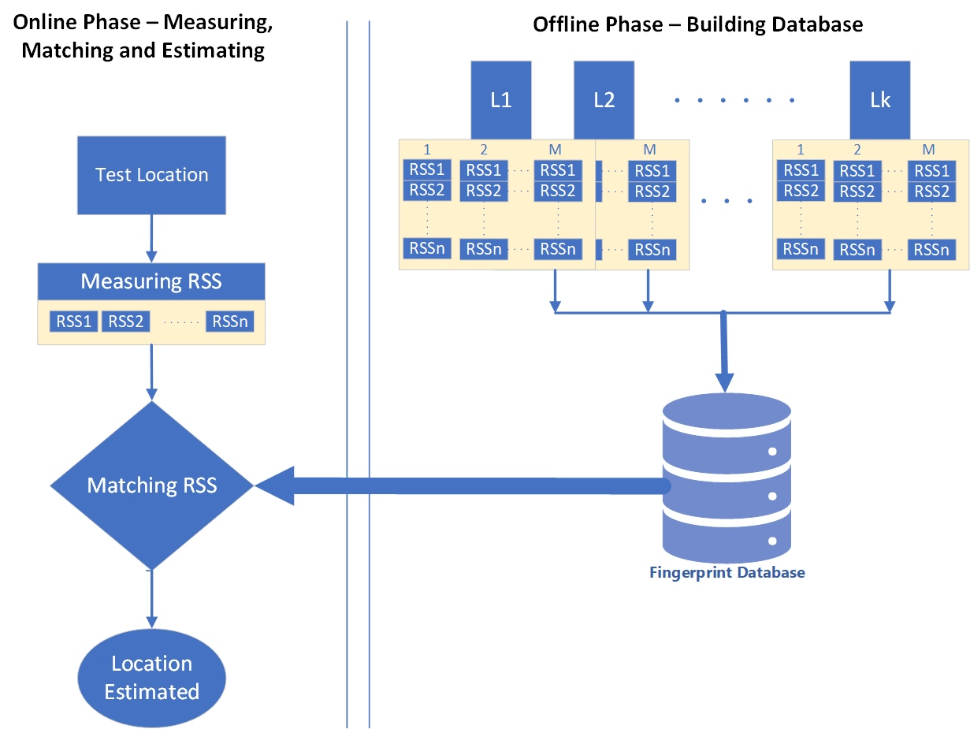
Applying RSS Test Results to AI Fingerprint Process to Estimate Location
RSS-based localization involves non-linear relationships between the RSS values from multiple LEDs and the physical location of the receiver.
ANN models are well-suited to model these non-linear relationships because they can “learn” from data to map RSS measurements to positions.
AI RSS fingerprinting process in OWC systems involves two main phases: the offline phase (training) and the online phase (testing or real-time localization).

Slide 15
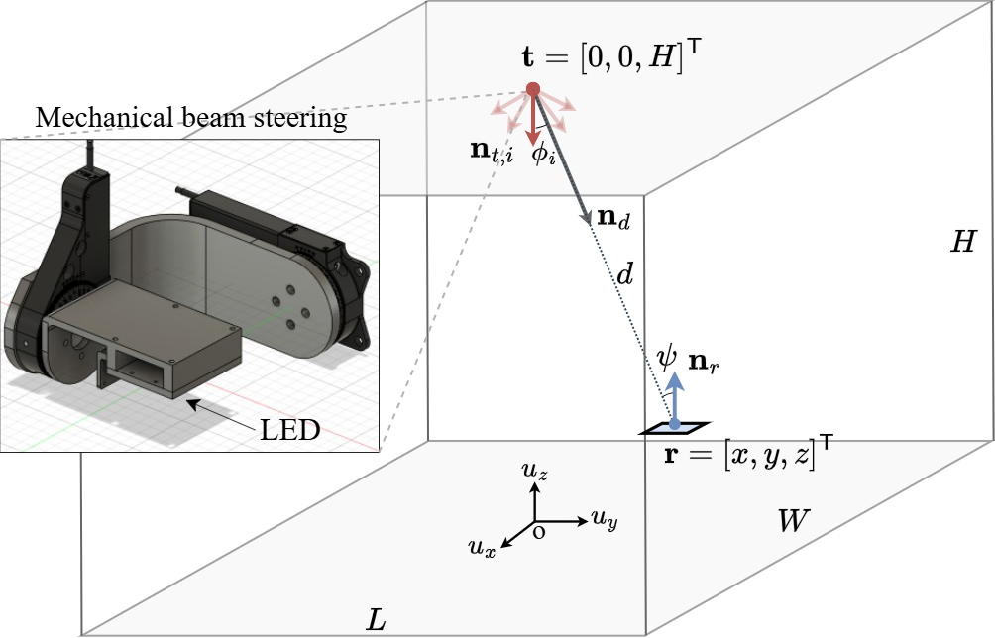
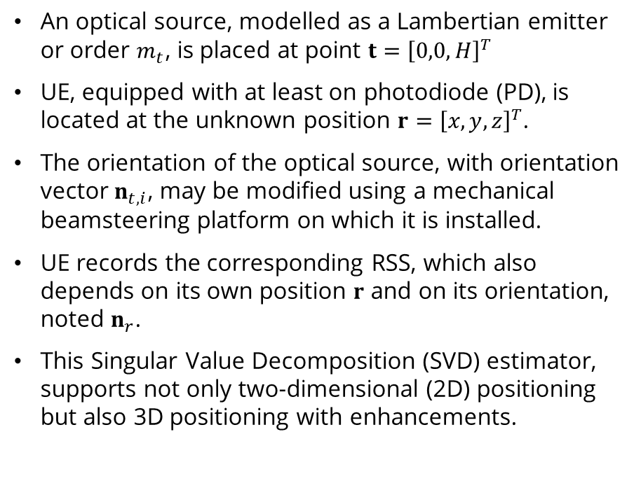
Beamsteering-Based Localisation
An optical source, modelled as a Lambertian emitter or order $m_{t}$, is placed at point $t={\left[0,0,H\right]}^{T}$
UE, equipped with at least on photodiode (PD), is located at the unknown position $r={\left[x,y,z\right]}^{T}$.
The orientation of the optical source, with orientation vector $n_{t,i}$, may be modified using a mechanical beamsteering platform on which it is installed.
UE records the corresponding RSS, which also depends on its own position $r$ and on its orientation, noted $n_{r}$.
This Singular Value Decomposition (SVD) estimator, supports not only two-dimensional (2D) positioning but also 3D positioning with enhancements.

Slide 16
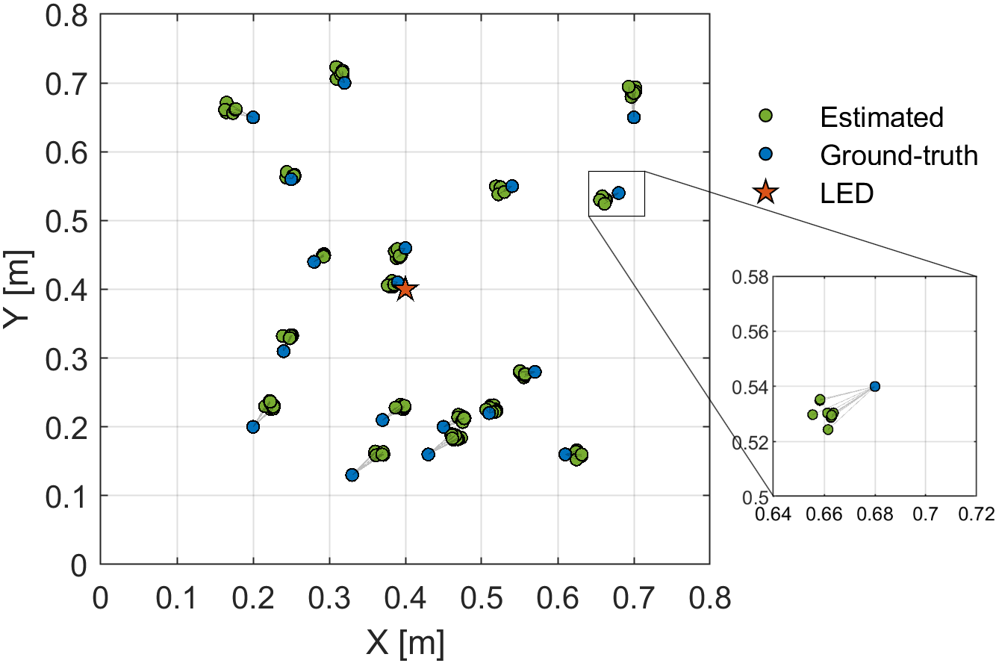
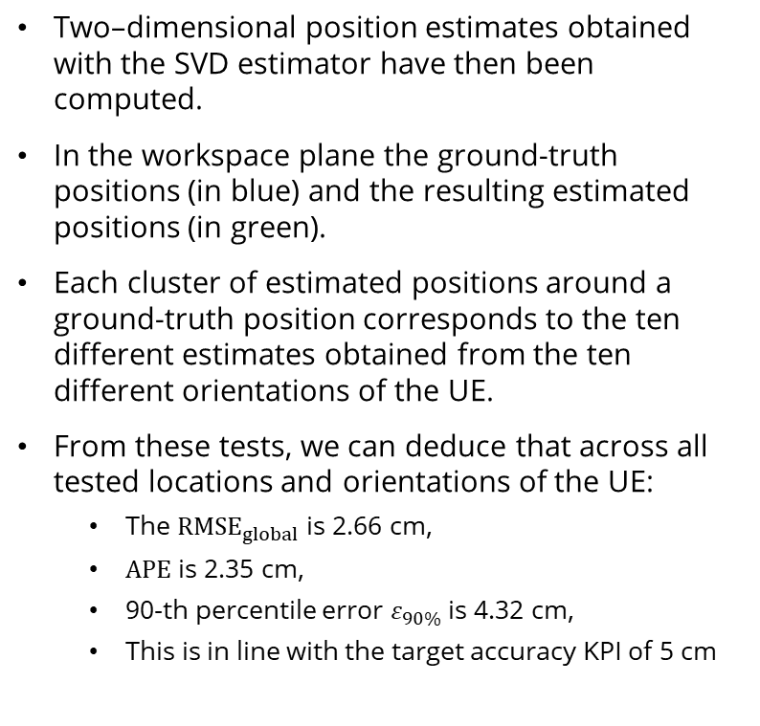
SVD Localisation First Results
Two–dimensional position estimates obtained with the SVD estimator have then been computed.
In the workspace plane the ground-truth positions (in blue) and the resulting estimated positions (in green).
Each cluster of estimated positions around a ground-truth position corresponds to the ten different estimates obtained from the ten different orientations of the UE.
From these tests, we can deduce that across all tested locations and orientations of the UE:
  The ${RMSE}_{global}$ is 2.66 cm,
  $APE$ is 2.35 cm,
  90-th percentile error $ε_{90\%}$ is 4.32 cm,
  This is in line with the target accuracy KPI of 5 cm

Slide 17
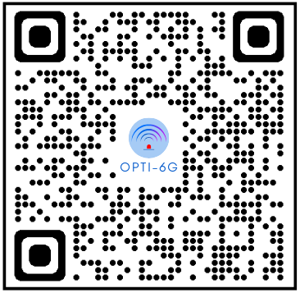
Thank you for your attention!
https://opti-6g.sns-ju.eu/

